Slide 1

How does Employment and Housing Inventory Affect O.C. Home Values?
Team 7 Members:
Chithra Kumar – Team Lead
Yolanda
Nathan Roberts
Sujit Singh

Slide 2
Project Outline
Orange County Real Estate Market
Project Summary
Overview
Approach
Challenges
Project Details
Data Gathering
Data Cleanup
Data Explorations
Data Issues
Data Analysis & Insights
Results
Q & A
2

Slide 3
Approach
Orange County Real Estate Market
Overview
How do Employment Rates and Housing Inventory affect the Orange County Real Estate Market?
Approach and Data Collection:
Our approach was to collect data for Housing Price Index, Employment Rates and Housing Inventory from reliable web data sources. Using API requests and then using Python to cleanse and analyze the information for trends and correlation to increases in the Real Estate Market
Research Questions to Answer:
What trends are responsible for the increase in O.C. home values?
How has Unemployment rates affect property values?
Has an increase or decrease in inventory played a significant role?

Slide 4

Challenges
Orange County Real Estate Market
Data Issues
Finding Reliable Data Sources
Learning the Cost of Valuable Data
Narrowing Down Research Questions
How to Apply Information to Research Questions
How to Align Results from Different Data Sources

Slide 5
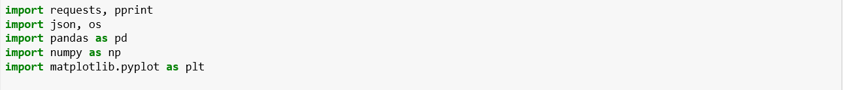
Technologies Used:
Orange County Real Estate Market
Visual Studio
GitHub
Jupyter Notebook
Python
Pandas
Numpy
API
JSON
Matplotlib

Slide 6
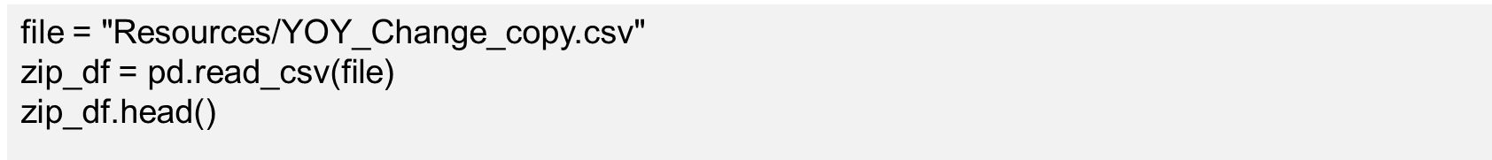
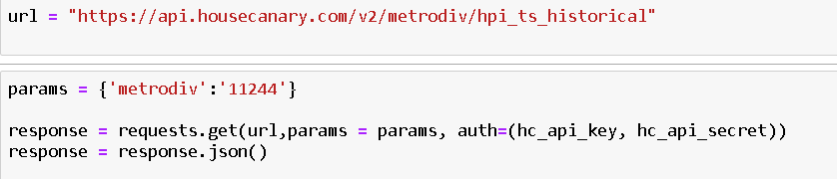
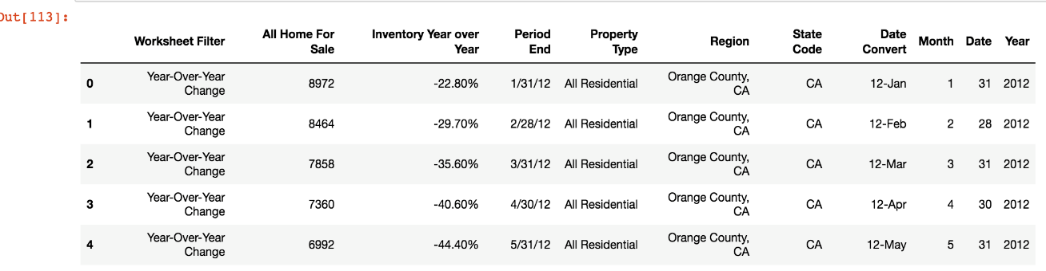

Data Sources
Orange County Real Estate Market
API Data Source:
https://api.housecanary.com/v2/metrodiv/hpi_ts_historical
Flat File Source:
RedFin

Slide 7

Data Gathering Examples

Slide 8
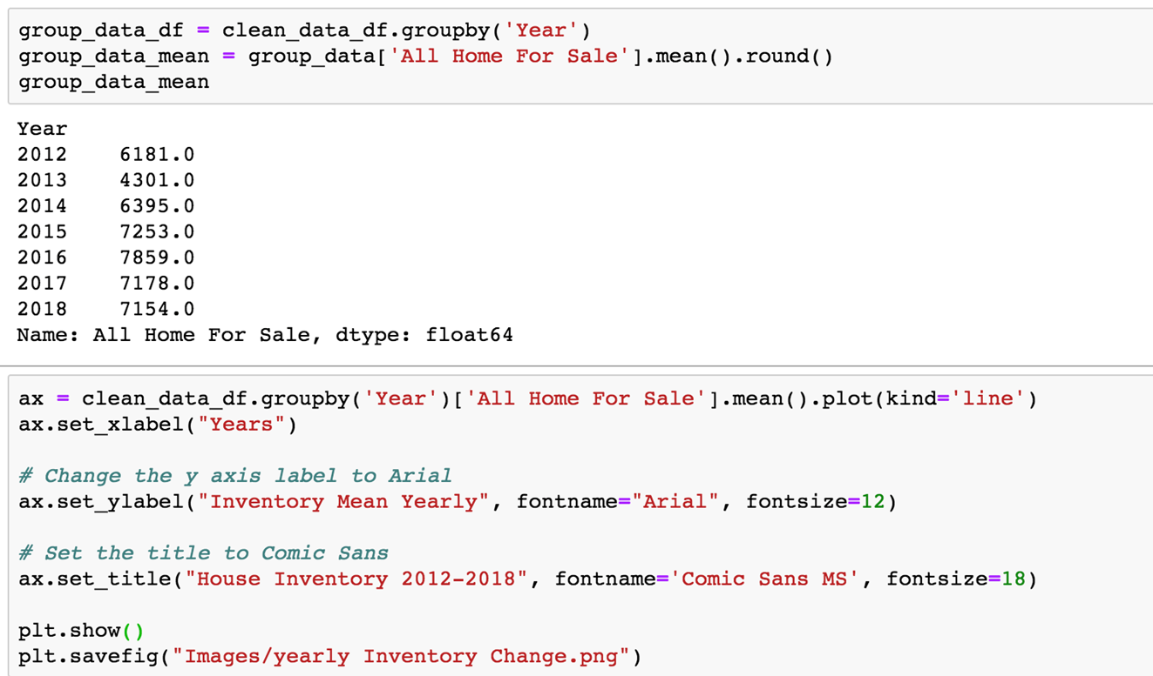
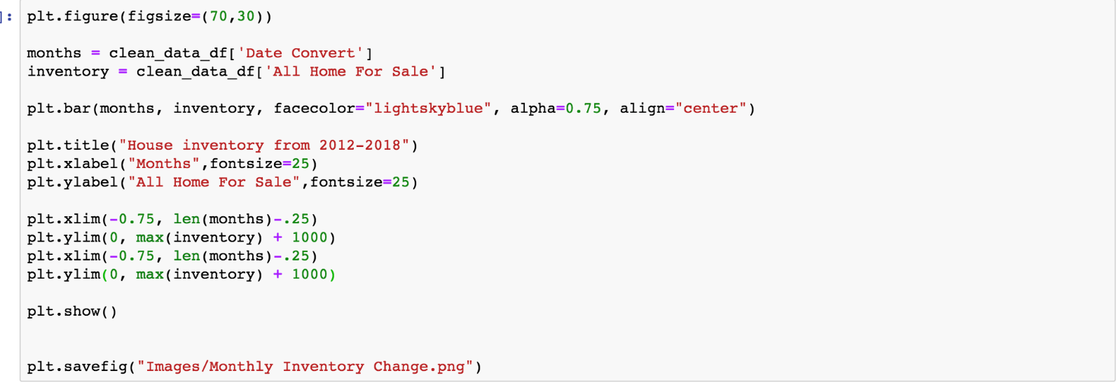
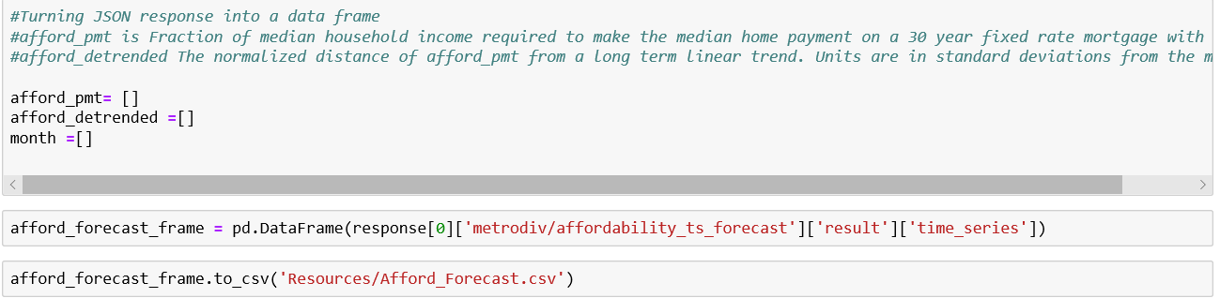
Data Processing

Slide 9
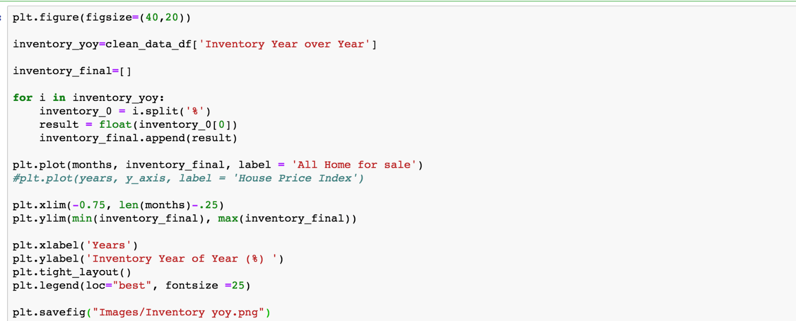
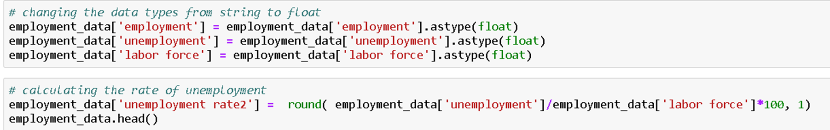
Data Processing
Data Exploration

Slide 10

Data Cleaning Examples

Slide 11
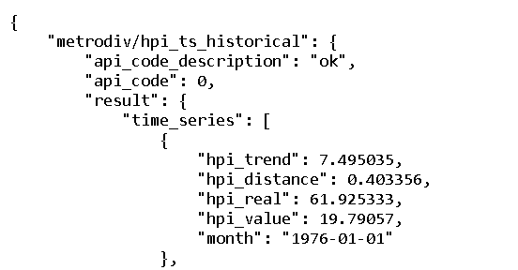
Data Cleaning

Slide 12
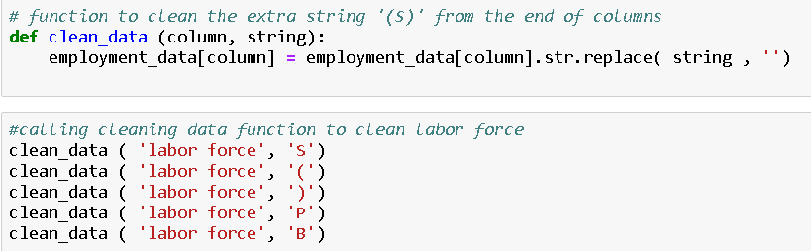
Data Cleaning

Slide 13
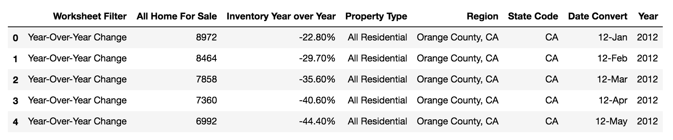
Data Cleaning
Filter the data by “Year-Over-Year Change” , Region: “Orange County
Convert Date Format in Excel, and then split it in three different columns : Month, Date, Year
Eg. 01/31/2012 to Jan-2012, Month: 1, Date: 31, Year: 2012
#drop Unwanted columns:
clean_data_df = zip_df.drop(['Month', 'Date', 'Period End'], axis=1)
clean_data_df.head(

Slide 14


Slide 15
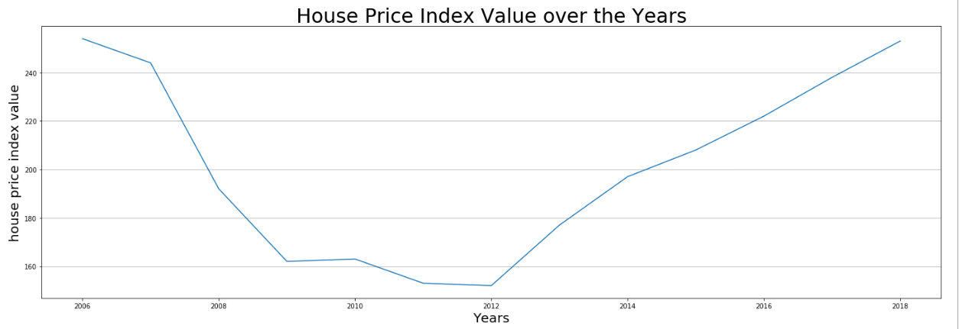
Overview of Current O.C. Housing Market
The graph shows historical house price index(HPI) value from 2006 – 2018. The HPI is a broad measure of real estate prices that provides a clearer picture of market trends over traditional tools such as mean or median average prices.

Slide 16
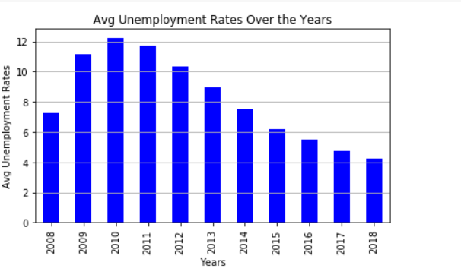
Data Analysis

Slide 17
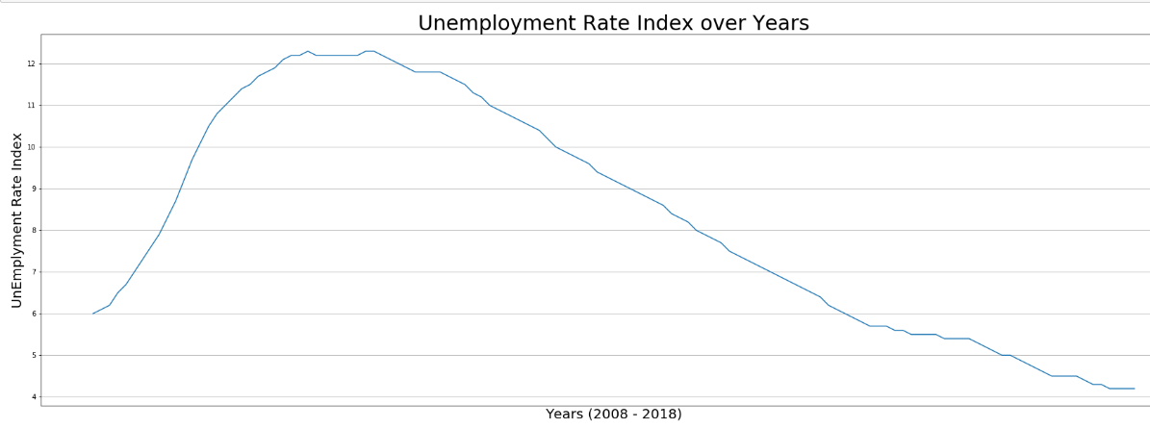
How has Unemployment rates affect property values and inventory?

Slide 18
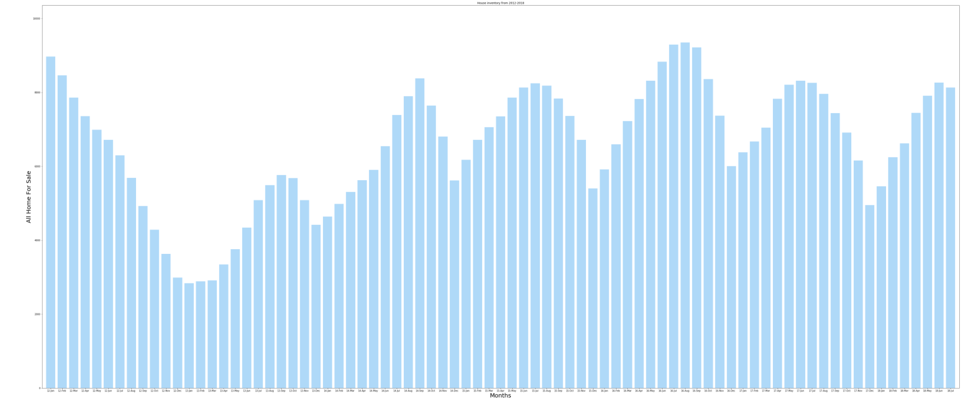
Inventory Bar Graph
The graph shows inventory from 2012 – 2018. The inventory shows all home for sale that recorded in Redfin DataCenter. The bar graph shows the monthly change of the real estate inventory in orange county.

Slide 19
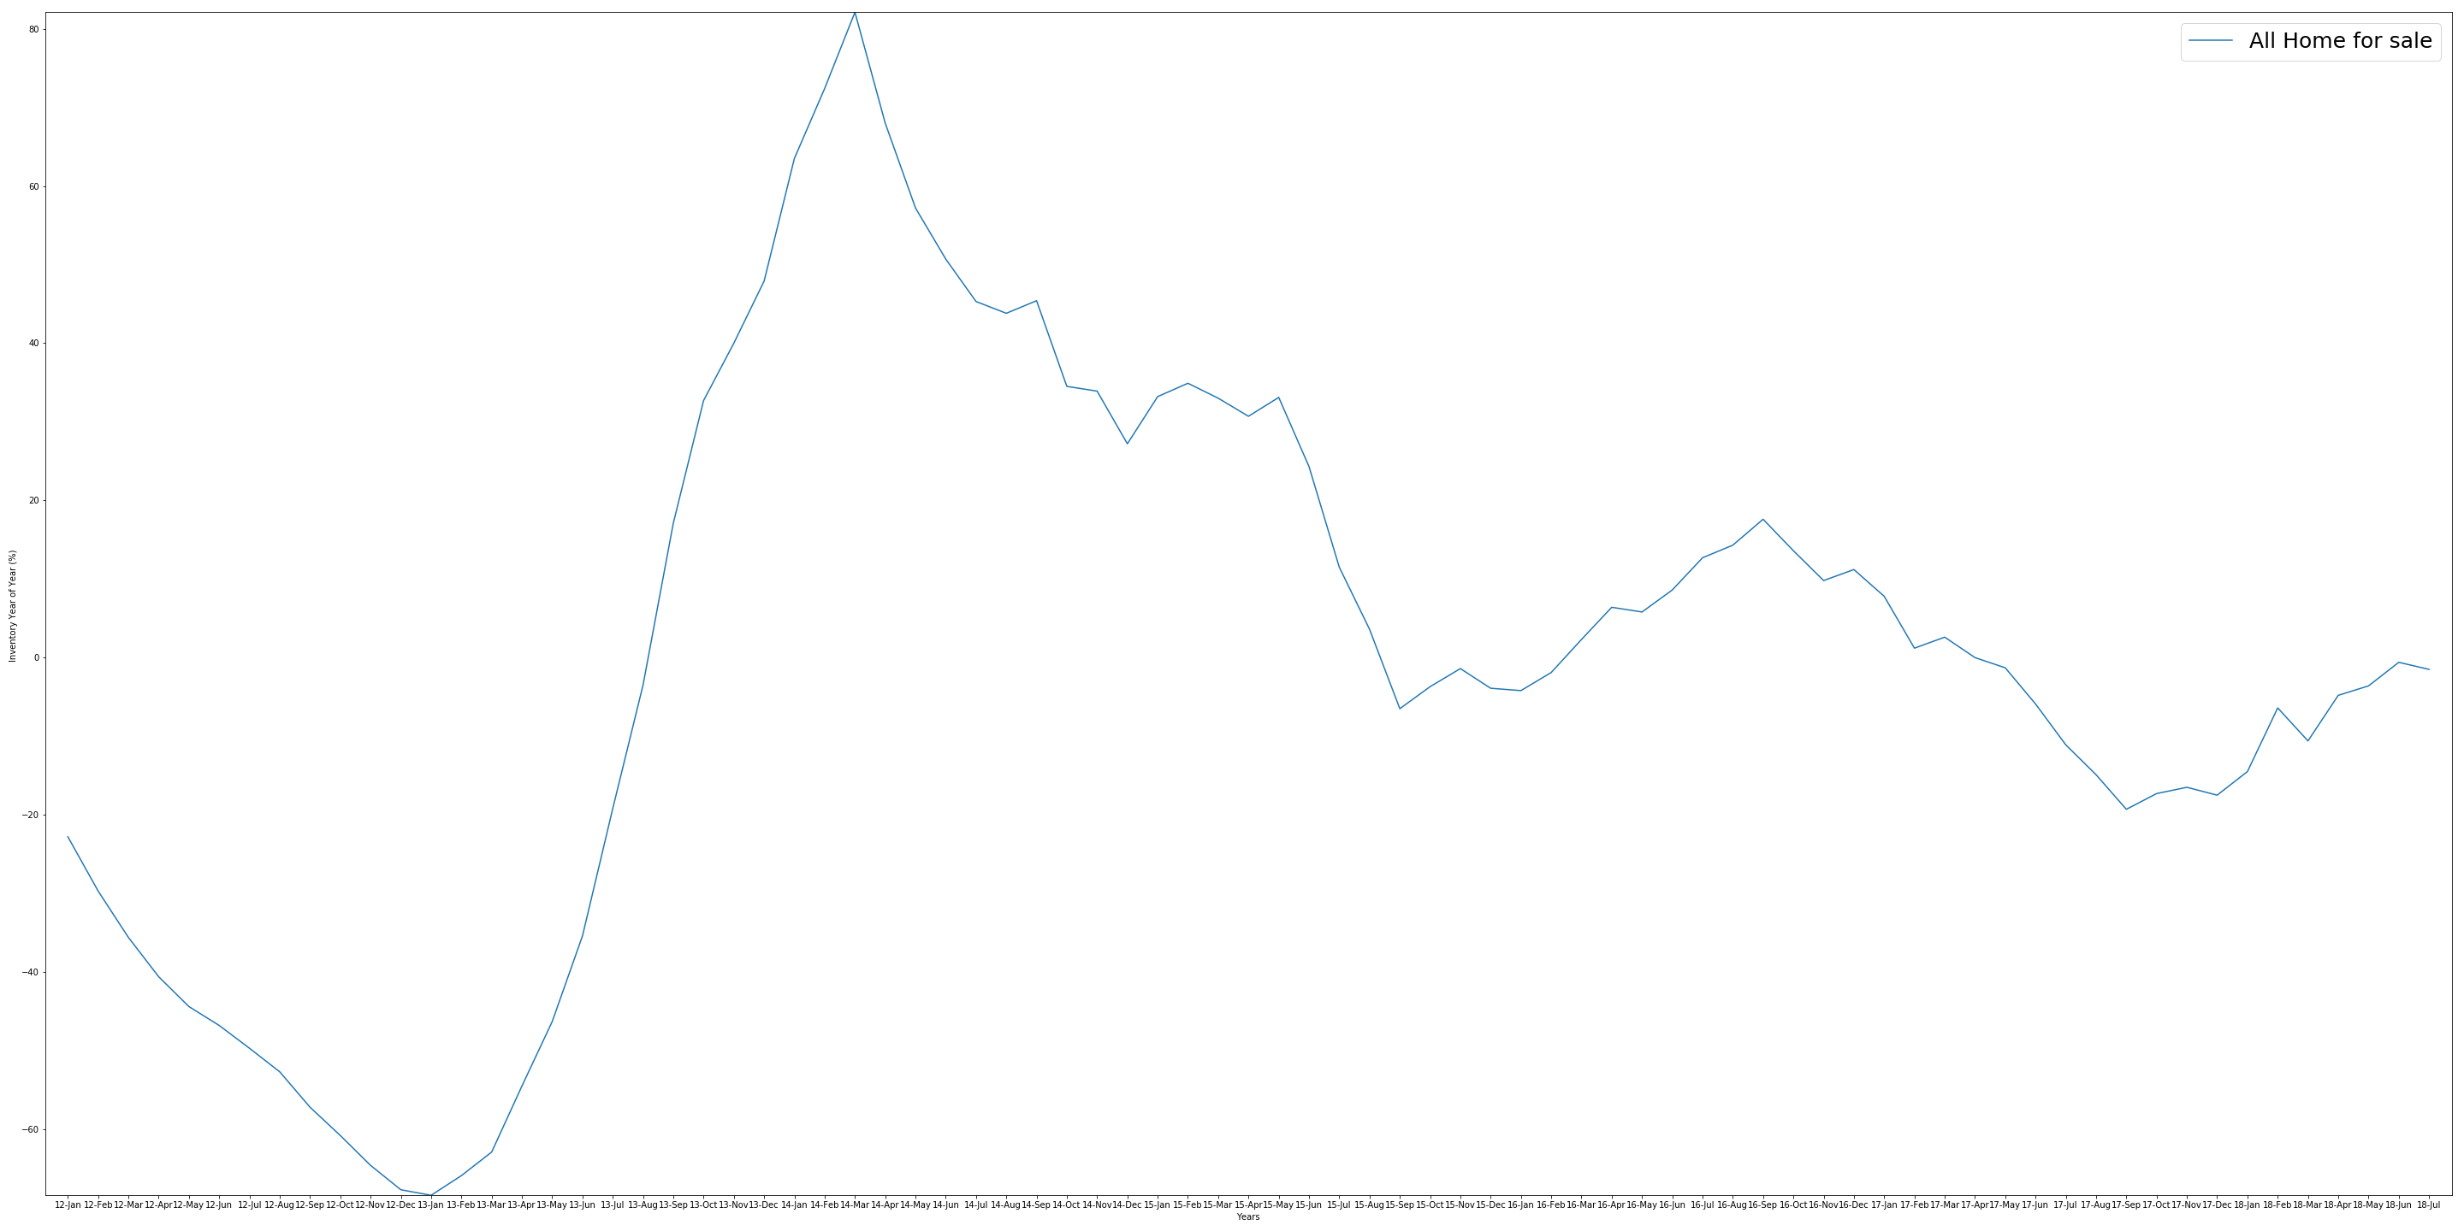
Inventory Mean Line Graph
The graph shows inventory mean from 2012 – 2018. The line graph clearly represents the pick and bottom of the real estate inventory in orange county. We can see that in 2013 the inventory was reach the bottom (-68.4%) and 2014 it reaches the pick (82.1%).

Slide 20
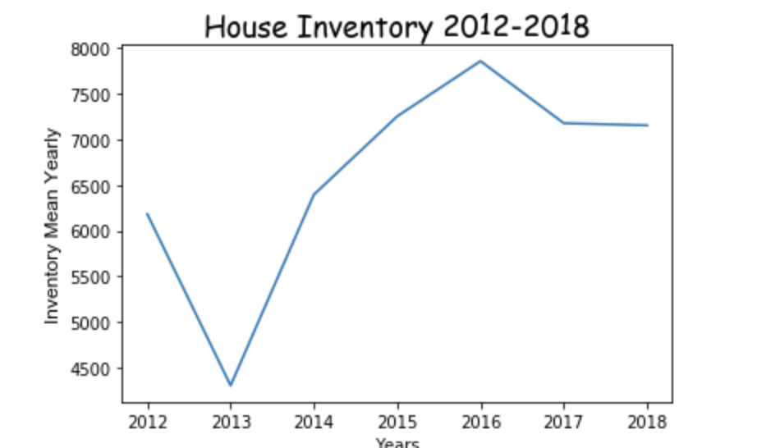
How Inventory affect the Housing market

Slide 21
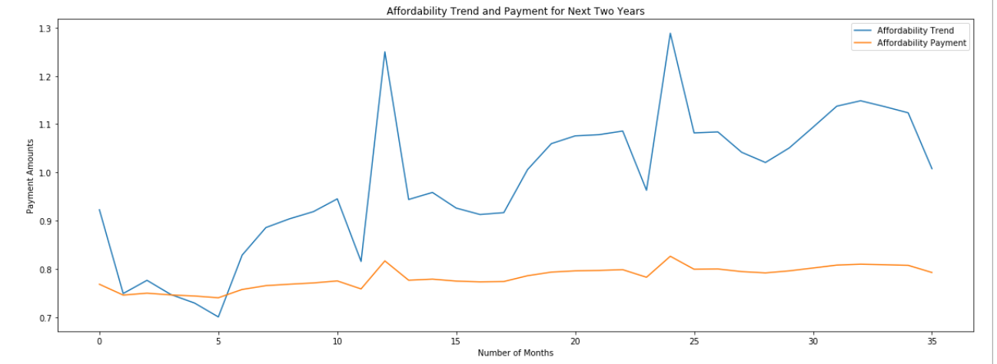
Future Pricing OC Housing Trends
Orange County Real Estate Market
??

Slide 22

Results & Insights

Slide 23
Data Analysis & Insights
The inventory for Orange county area shows a positive trend from 2013 to 2016, and then the inventory decreased and keep stable. We learned that the inventory mean was 4301 in 2013, and become 7859 in 2016. Between 2014-2018, the inventory has the negative trend but has slightly increasing. At the same time , the house price stilling increasing gradually. We can say that the inventory in Orange County is not main effector for the house price.

Slide 24
Data Analysis & Insights: Employment Data
The national unemployment rate for OC Metro area shows a positive trend. We learned that the unemployment rate dropped to 4.3% which is an all-time low in the last 12 years. The low rate seems to be benefiting a resurgent housing market as we can see a steady increase in the HPI value. The improved job market leads to increased consumer confidence and leads to more transactions in the housing market.

Slide 25
Data Analysis & Insights: Conclusion
Inventory doesn’t show a significant correlation
Unemployment rates have a better relationship to home values
The trends show to increase an continued increase in home values in the next 35 months.

Slide 26
Questions and Answers
Orange County Real Estate Market
?

